Slide 1


«Multimodal treatment of obesity. RCTs e importanza della metodologia clinica»
Napoli, 19 febbraio 2026
Dr. Matteo Monami
Careggi Teaching Hospital,
Firenze

Slide 2
Il Dr. M. Monami ha ricevuto speaking fees/grant da:
Boehringer
Lilly
Novonordisk
Biocomposites
Molteni
e da Società Scientifiche:
SICOB
IFSO
EASO
SIO
ESE

Slide 3
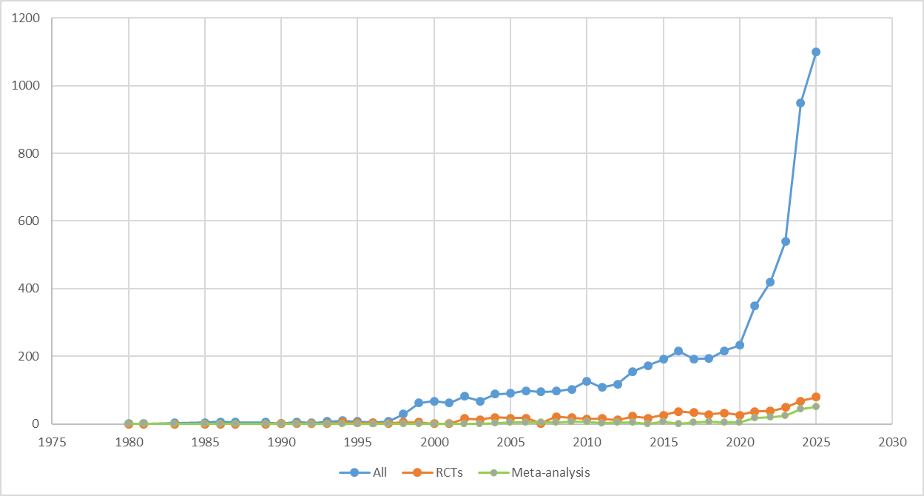
Pyramid of scientific evidence: efficacy and safety based on RCT
Search string: (obesity or overweight) AND (orlistat OR naltrexone OR bupropion OR Liragl. OR Semagl. OR Tirzep. OR phentermine/topiramate)
Trials on OMM; N= 28 up to 31st, Jan 1999

Slide 4

Pyramid of scientific evidence: efficacy and safety based on RCT
Search string: (obesity or overweight) AND (orlistat OR naltrexone OR bupropion OR Liragl. OR Semagl. OR Tirzep. OR phentermine/topiramate)
Trials on OMM: 28 up to 31st, Jan 1999

Slide 5
The Eminence Based Medicine

Slide 6
How to manage all this info?
Search string: (obesity or overweight) AND (orlistat OR naltrexone OR bupropion OR Liragl. OR Semagl. OR Tirzep. OR phentermine/topiramate)
Trials on OMM; N= 798 up to 31st, December 2025

Slide 7
The Evidence Based Medicine

Slide 8

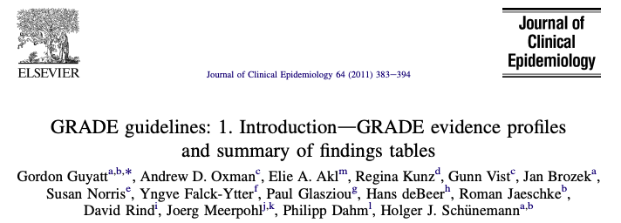
GRADE: Grading of Recommendations, Assessment, Development and Evaluation
8
Notes:
The primary objective of the Look AHEAD clinical trial is to assess the long-term effects (up to 11.5 years) of an intensive weight loss program delivered over 4 years in overweight and obese individuals with type 2 diabetes.

Slide 9
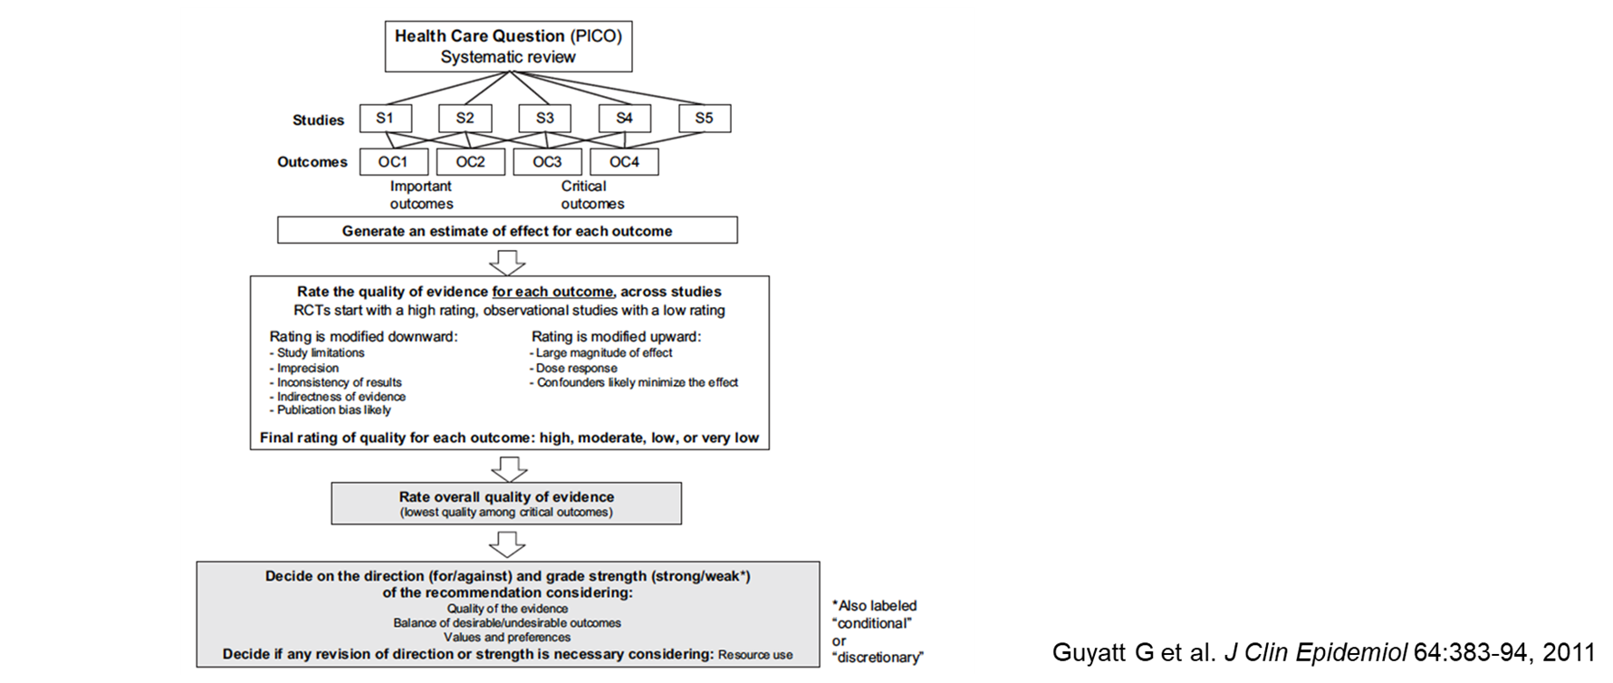
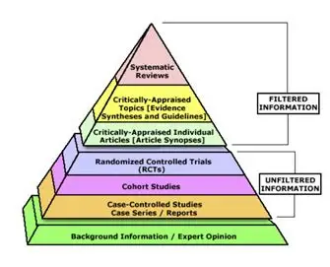
How to manage all this info?
GRADE
= Meta-analysis

Slide 10

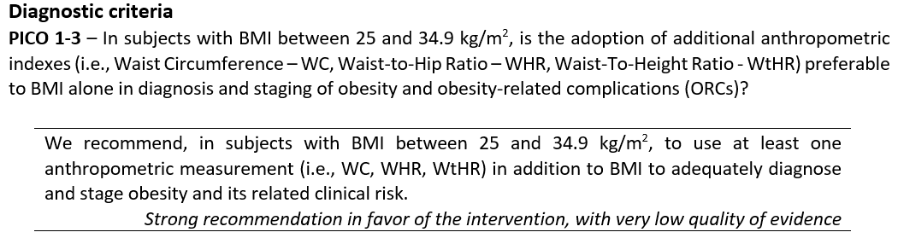
Obesity definition
GRADE
Barazzoni R et al., Eating and Weight Disorders; 2026, In press
10
Notes:
The primary objective of the Look AHEAD clinical trial is to assess the long-term effects (up to 11.5 years) of an intensive weight loss program delivered over 4 years in overweight and obese individuals with type 2 diabetes.

Slide 11
Obesity definition
GRADE
P
I
C
O
Barazzoni R et al., Eating and Weight Disorders; 2026, In press
11
Notes:
The primary objective of the Look AHEAD clinical trial is to assess the long-term effects (up to 11.5 years) of an intensive weight loss program delivered over 4 years in overweight and obese individuals with type 2 diabetes.

Slide 12
Obesity definition
GRADE
Barazzoni R et al., Eating and Weight Disorders; 2026, In press
12
Notes:
The primary objective of the Look AHEAD clinical trial is to assess the long-term effects (up to 11.5 years) of an intensive weight loss program delivered over 4 years in overweight and obese individuals with type 2 diabetes.

Slide 13
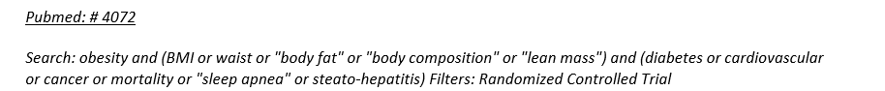
Obesity definition
GRADE
Barazzoni R et al., Eating and Weight Disorders; 2026, In press
13
Notes:
The primary objective of the Look AHEAD clinical trial is to assess the long-term effects (up to 11.5 years) of an intensive weight loss program delivered over 4 years in overweight and obese individuals with type 2 diabetes.

Slide 14
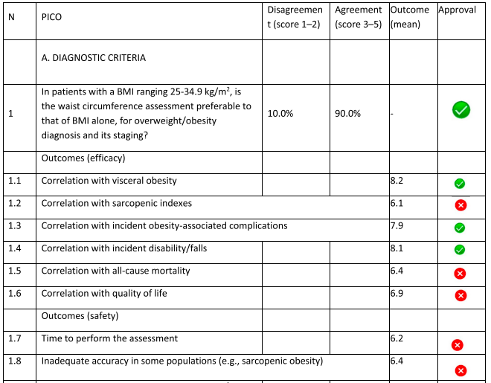
Obesity definition
GRADE
Barazzoni R et al., Eating and Weight Disorders; 2026, In press
14
Notes:
The primary objective of the Look AHEAD clinical trial is to assess the long-term effects (up to 11.5 years) of an intensive weight loss program delivered over 4 years in overweight and obese individuals with type 2 diabetes.

Slide 15
Obesity definition
GRADE
Barazzoni R et al., Eating and Weight Disorders; 2026, In press
15
Notes:
The primary objective of the Look AHEAD clinical trial is to assess the long-term effects (up to 11.5 years) of an intensive weight loss program delivered over 4 years in overweight and obese individuals with type 2 diabetes.

Slide 16
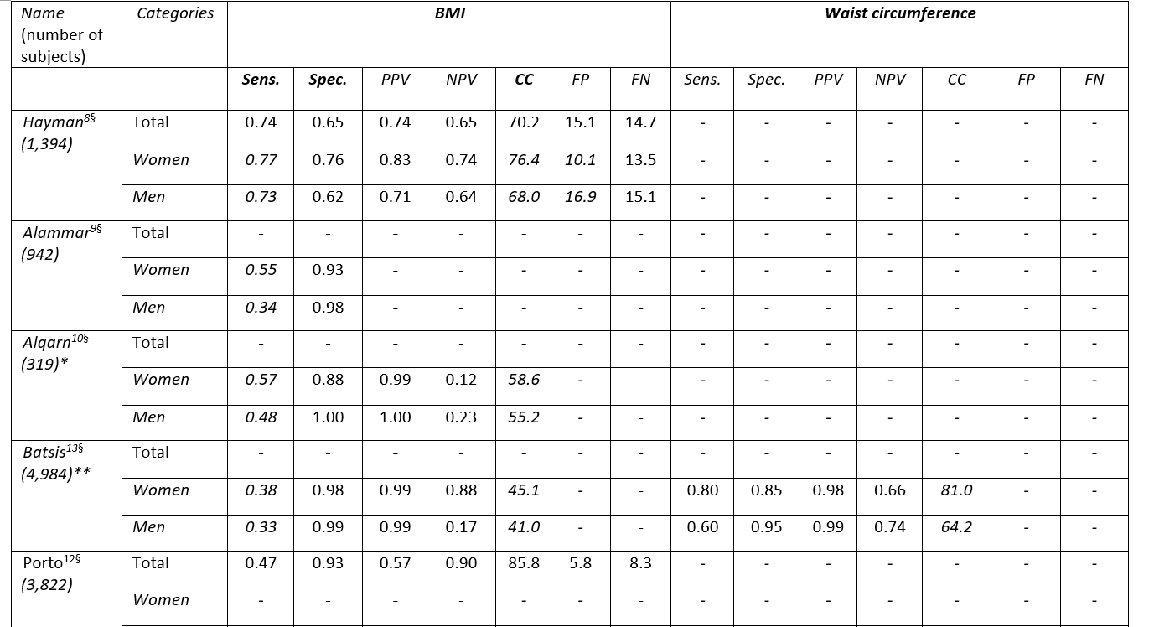
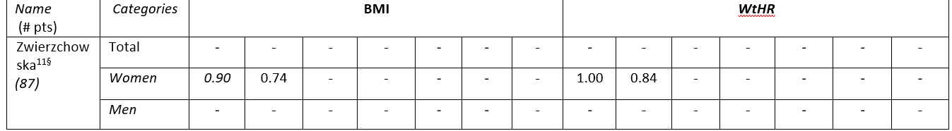
Obesity definition
16
Notes:
The primary objective of the Look AHEAD clinical trial is to assess the long-term effects (up to 11.5 years) of an intensive weight loss program delivered over 4 years in overweight and obese individuals with type 2 diabetes.

Slide 17
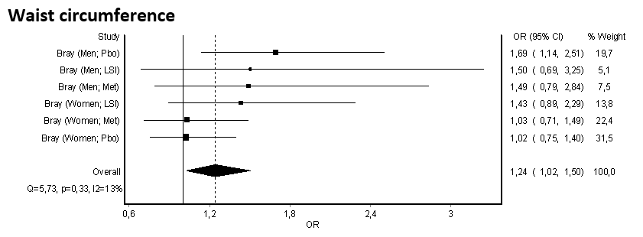
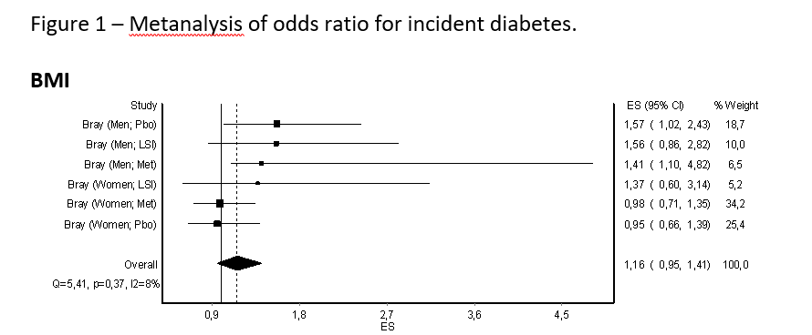
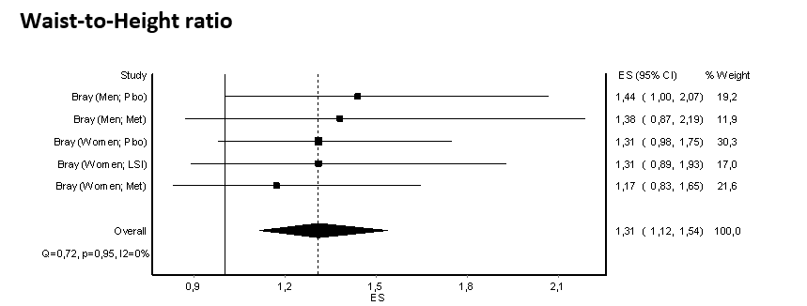
Obesity definition
Incident diabetes
Barazzoni R et al., Eating and Weight Disorders; 2026, In press
17
Notes:
The primary objective of the Look AHEAD clinical trial is to assess the long-term effects (up to 11.5 years) of an intensive weight loss program delivered over 4 years in overweight and obese individuals with type 2 diabetes.

Slide 18
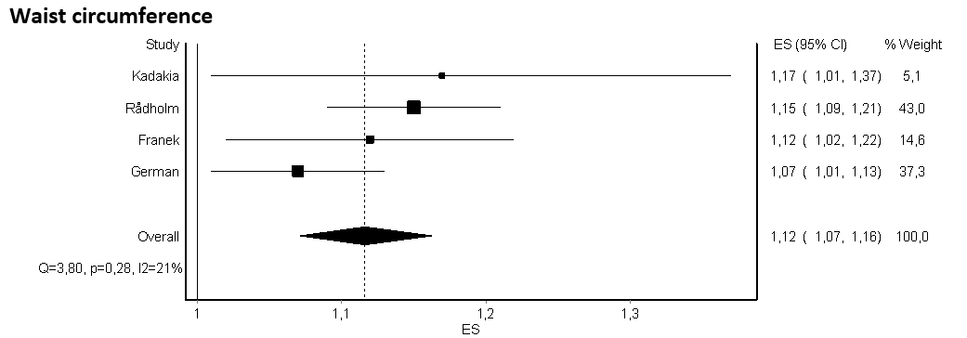
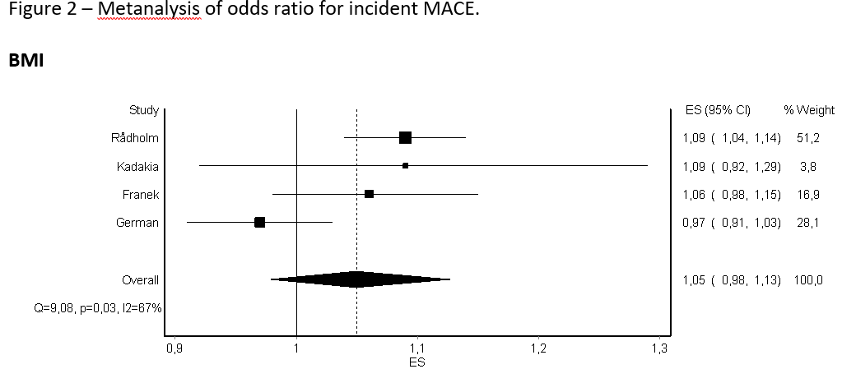
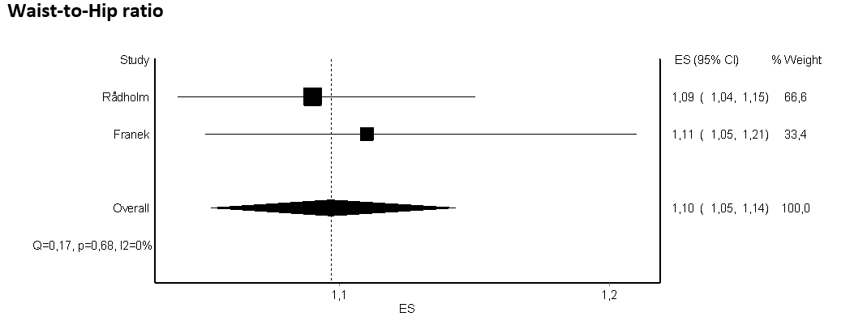
Obesity definition
Incident MACE
Barazzoni R et al., Eating and Weight Disorders; 2026, In press
18
Notes:
The primary objective of the Look AHEAD clinical trial is to assess the long-term effects (up to 11.5 years) of an intensive weight loss program delivered over 4 years in overweight and obese individuals with type 2 diabetes.

Slide 19
Obesity definition
GRADE
Barazzoni R et al., Eating and Weight Disorders; 2026, In press
19
Notes:
The primary objective of the Look AHEAD clinical trial is to assess the long-term effects (up to 11.5 years) of an intensive weight loss program delivered over 4 years in overweight and obese individuals with type 2 diabetes.

Slide 20
Obesity definition
GRADE
Barazzoni R et al., Eating and Weight Disorders; 2026, In press
20
Notes:
The primary objective of the Look AHEAD clinical trial is to assess the long-term effects (up to 11.5 years) of an intensive weight loss program delivered over 4 years in overweight and obese individuals with type 2 diabetes.

Slide 21
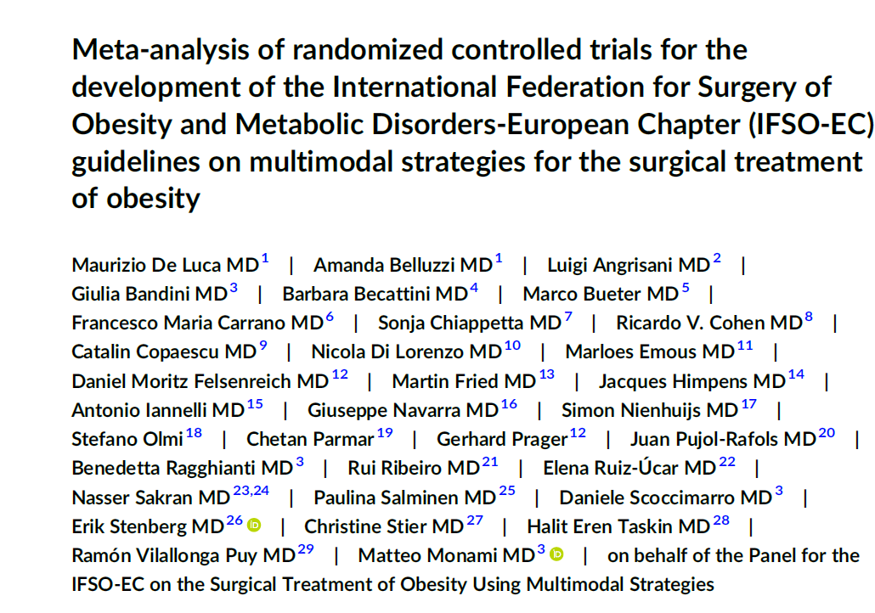
Briefly, the present analysis includes all RCTs enrolling patients affected by obesity undergoing different MBS procedures (AGB, SG, RYGB, OAGB, SADI-S, VBG, BPD, and GCP) in addition to other anti-obesity strategies (extensive lifestyle interventions—LSI, OMM, or EP), with a duration of at least 6 months. RCTs excluded were on either recurrent weight gain (WR) or insufficient weight loss (IWL) after MBS unless the use
of LSI or other obesity-management strategies was preplanned for all included patients (not only for those with suboptimal clinical response).

Slide 22
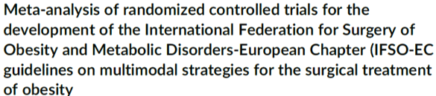
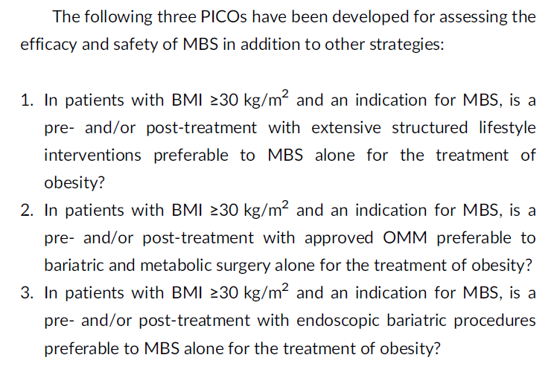

Slide 23
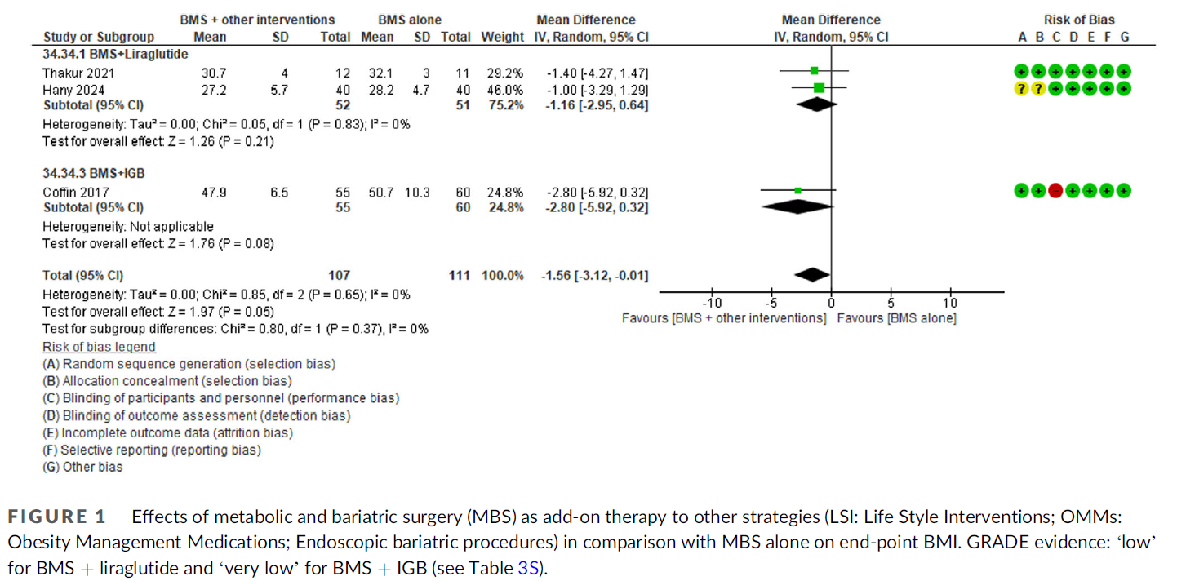
6-month FU after MBS
*
*From 6 weeks post-operative until 6 months

Slide 24
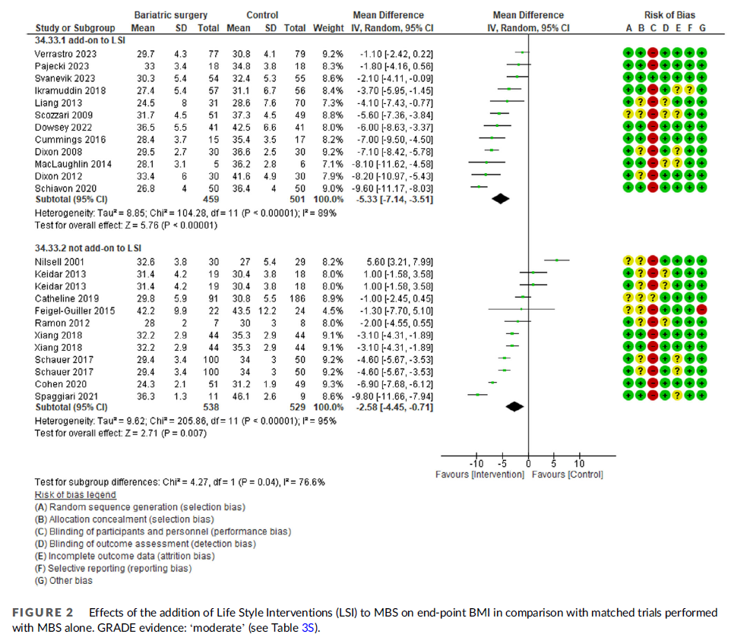
MBS+LSI vs LSI
MBS vs LSI

